Slide 1

Intro to Azure and Data Platforms
DSBA 6190-U90 | Colby T. Ford, Ph.D.

Slide 2
Overview
About Microsoft Azure
Unstructured Data Storage
Azure Storage
Azure Data Lake
Structured Data Storage
Azure SQL DB
Azure Synapse

Slide 3

Top Benefits of Cloud Computing
Types of Clouds
Service Offerings
Regions
https://azure.microsoft.com/en-us/overview/what-is-cloud-computing/

Slide 4
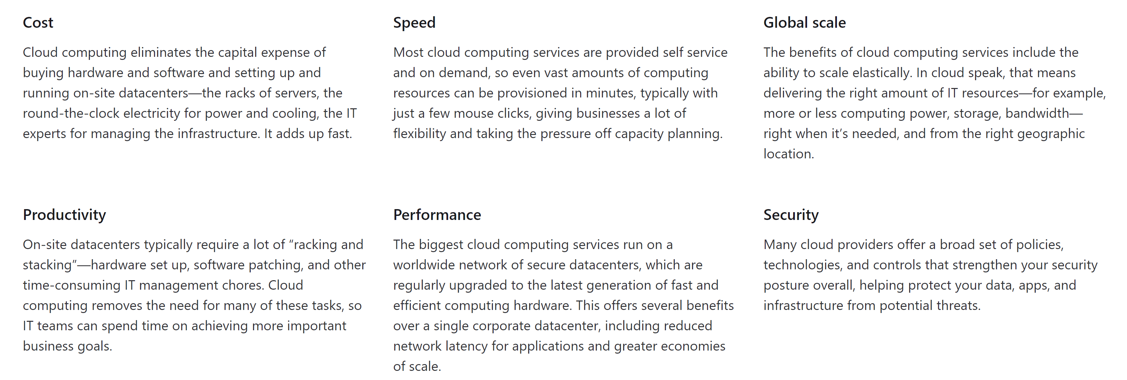
Top Benefits of Cloud Computing

Slide 5
Types of Clouds
Public Cloud
Private Cloud
Hybrid Cloud
Owned and operated by third-party cloud service providers
Deliver computing resources like servers and storage over the internet
Owned exclusively by a single business or organization
Can be physically located on the company's on-site datacenter
Could also be hosted by a third-party service provider, but maintained by the organization on a private network
Somewhere in the middle of public and private
Bound by technologies that allows data and applications to be shared between them
Most flexible option as it allows for a broad range of deployment options
Most control over security and compliance

Slide 6
Types of Cloud Services
PaaS
Services that provide on-demand environments for developing, testing, delivering, and managing software applications
No (less) need to manage underlying infrastructure
SaaS
Software
Delivery of software applications over the internet
Serverless
Overlaps with PaaS
Focuses on building app functionality without spending time managing the servers and infrastructures required to do so
IaaS
Most basic form of cloud computing services
Rent IT infrastructure
Includes:
VMs, Storage, Networks, Operating Systems
Infrastructure
Platform
Usually as an on-demand/subscription basis
Cloud provider hosts and manages the software application and underlying infrastructure
Usually highly-scalable and event-driven

Slide 7
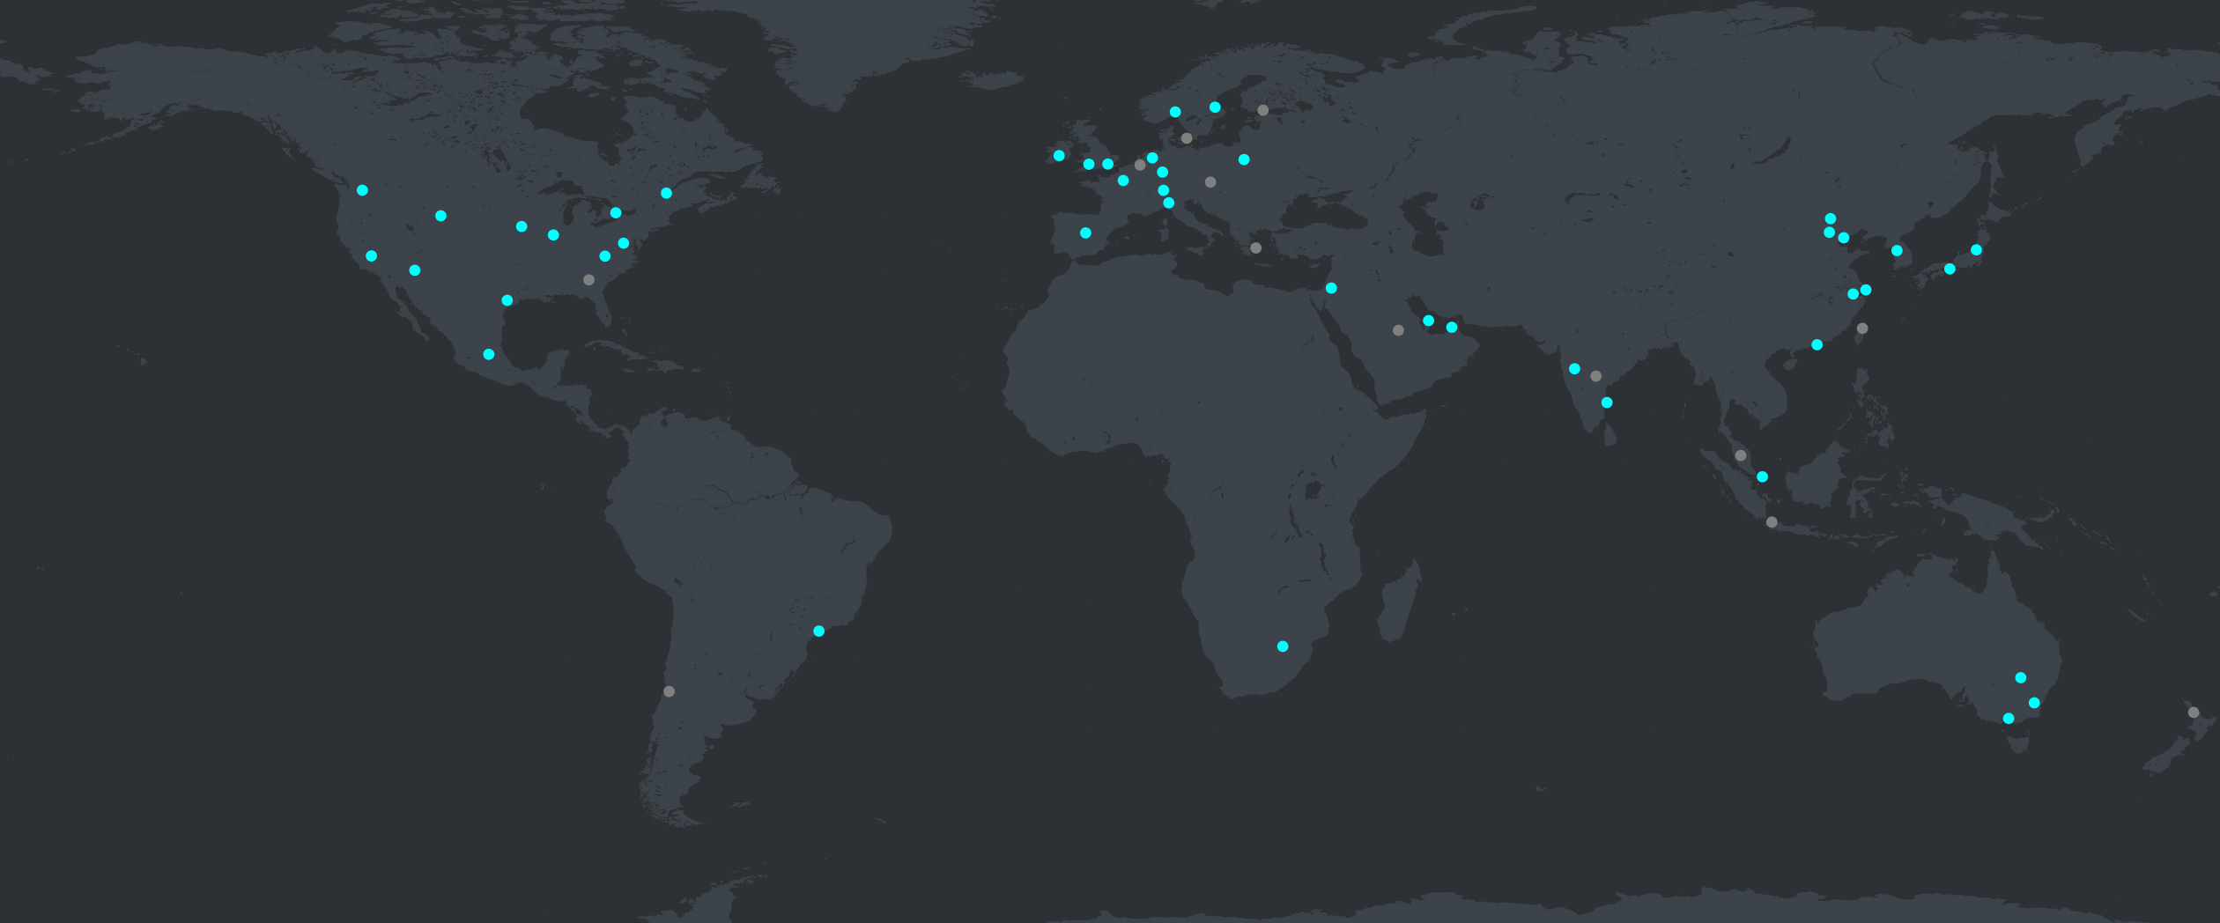
Azure Regions
60+ Azure Regions
https://datacenters.microsoft.com/globe/explore/

Slide 8
Reasons to Select a Region
Speed
Pick a region that is the closest to you will help increase the speed of moving data in and out from your resources.
Cost
You will face egress fees if you move data from one region to another. So, it's cheaper for you to have everything nearby.
Some services are cheaper in certain regions over others. Using the Azure calculator can help you estimate the cost differences.
Available Resources
Certain services are only available in certain regions. It might not be possible to have everything in the same place. (See Products by Region.)
Security and Compliance
Depending on the scenario, a particular data center might need to be selected for security and compliance reasons. (Such as government or China)

Slide 9
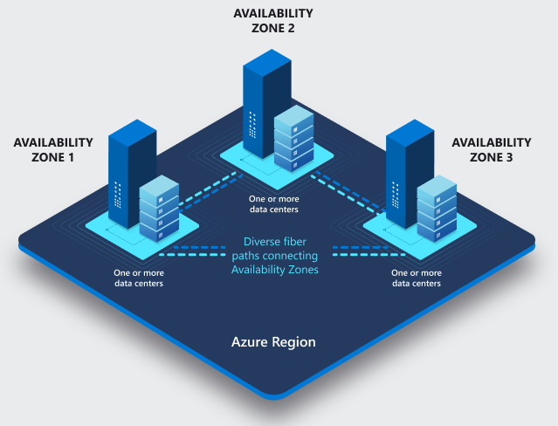
Availability Zones
Physically separate locations within each Azure region that are tolerant to local failures (earthquakes, floods, fires, etc.)
Tolerance to failures is achieved because of redundancy and logical isolation of Azure services.
Azure availability zones are connected by a high-performance network with a round-trip latency of less than 2ms.

Slide 10
Available Service Categories
AI + Machine Learning
Analytics
Compute
Containers
Databases
Developer Tools
DevOps
Identity
Integration
Internet of Things
Management and Governance
Media
Migration
Mobile
Networking
Security
Storage
Web
https://azure.microsoft.com/en-us/services/

Slide 11
Azure Storage
- Azure Data Lake Gen 2
Unstructured Data Storage

Slide 12

Azure Storage
File Simple, distributed, cross-platform file system Lift and shift migration Simple and inexpensive Move data to cloud with no coding | Disk Persistent, high-performance disk storage for every workload Low latency, high throughput Industry-leading, single-instance service-level agreement Enterprise-grade durability | Blob Massively-scalable object storage for unstructured data Cost-effective for massive volume Tiered storage options Single infrastructure with global reach
 | Archive Industry leading price point for storing rarely accessed data Data automatically encrypted at rest Seamless integration with hot and cool storage tiers Supported by leading Data Management partners | Data Lake Storage Secure, massively scalable data lake storage. Limitless storage for analytics data Optimized for Apache Spark and Hadoop analytics engines High-performance file system with support for fine-grained access control lists
Azure Storage provides cloud storage that is highly available, secure, durable, scalable, and redundant. Azure Storage includes Azure Blobs (objects), Azure Data Lake Storage Gen2, Azure Files, Azure Queues, and Azure Tables.
https://azure.microsoft.com/en-us/services/storage/?v=18.24

Slide 13
Storage Tiers
Hot
Cool
Archive
Hot is pretty much the default tier.
This tier is similar to Hot, though I think it goes underused.
You can think of this tier as the backup version of the other two.
Premium
Premium isn't really a tier but a different type of storage altogether.
This tier is better for important files that you might need to access, but only every once in a while.
It carries the same performance as Hot, but at a lower storage cost (and a higher data access cost). This tier is recommended for files that you may only access every month or so.
It provides the best performance for retrieving files quickly and often but carries the highest price tag.
This is used for files that you plan on consistently accessing, reading, or updating.
This tier has a very low storage costs, but it'll take a few hours to access to the data when you want it.
Archive is recommended for files you access every 6 months or so.
This provides access to block blobs consistently low latency, which is perfect for high frequency data transactions.
This carries the highest price tag.

Slide 14
Medallion Architecture
Bronze 🥉 - Ingesting Raw Data
The bronze layer contains unvalidated data. Data ingested in the bronze layer typically:
Silver 🥈 - Cleanse, Validate, and Deduplicate
Recall that while the bronze layer contains the entire data history in a nearly raw state, the silver layer represents a validated, enriched version of our data that can be trusted for downstream analytics.
Gold 🥇 - Curate to Power Analytics
This gold data is often highly refined and aggregated, containing data that powers analytics, machine learning, and production applications. While all tables in the lakehouse should serve an important purpose, gold tables represent data that has been transformed into knowledge, rather than just information.
Maintains the raw state of the data source.
Is appended incrementally and grows over time.
Can be any combination of streaming and batch transactions.
Retaining the full, unprocessed history of each dataset in an efficient storage format provides the ability to recreate any state of a given data system.
Additional metadata (such as source file names or recording the time data was processed) may be added to data on ingest for enhanced discoverability, description of the state of the source dataset, and optimized performance in downstream applications.
While Databricks believes strongly in the lakehouse vision driven by bronze, silver, and gold tables, simply implementing a silver layer efficiently will immediately unlock many of the potential benefits of the lakehouse.
For any data pipeline, the silver layer may contain more than one table.
Analysts largely rely on gold tables for their core responsibilities, and data shared with a customer would rarely be stored outside this level.
Updates to these tables are completed as part of regularly scheduled production workloads, which helps control costs and allows service level agreements (SLAs) for data freshness to be established.
While the lakehouse doesn’t have the same deadlock issues that you may encounter in a enterprise data warehouse, gold tables are often stored in a separate storage container to help avoid cloud limits on data requests.
In general, because aggregations, joins, and filtering are handled before data is written to the gold layer, users should see low latency query performance on data in gold tables.

Slide 15
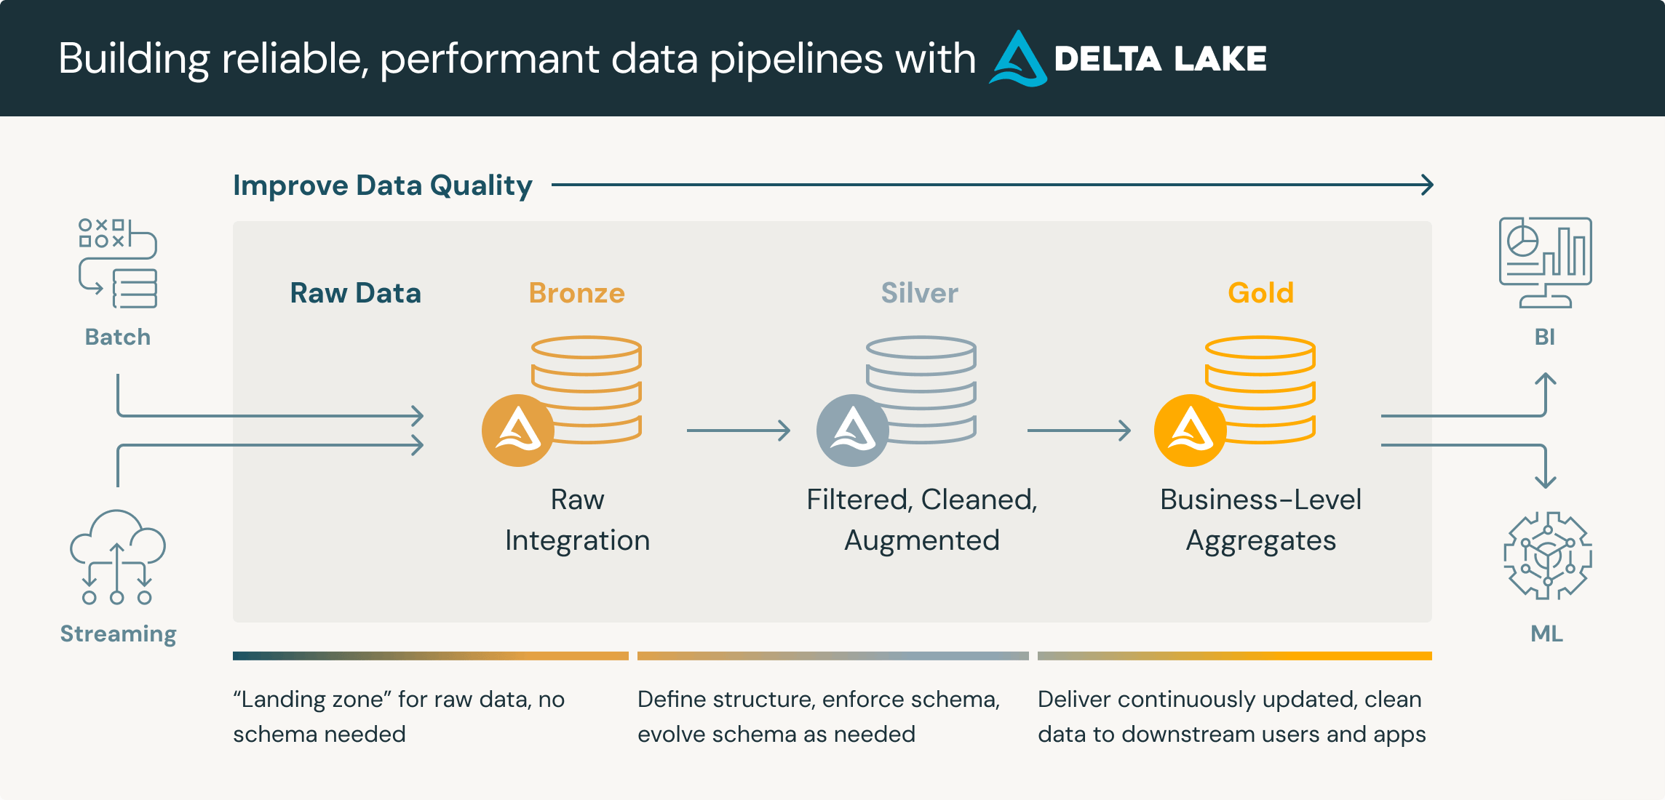
https://www.databricks.com/glossary/medallion-architecture

Slide 16
Begin lab…

Slide 17
Azure SQL Database
Azure Synapse
Other SQL-based Offerings
Structured Data Storage

Slide 18
Databases vs. Data Warehouses
Databases:
Usually for record-keeping of transactional systems
OLTP – Online Transactional Processing
Usually for a single application (personnel database, EMR, POS, etc.)
Focused on performance
Relational Schema
Highly normalized tables
Both:
Have multiple tables connected by keys
Use the same data types, indices, etc.
Can use views
Can be run on Azure SQL DB or Azure SQL DW
Data Warehouses:
Usually for keeping organizational historical data
OLAP – Online Analytical Processing
Usually for multiple systems combined
Focused on aggregation
Star or Snowflake Schema
Dimensions and Facts

Slide 19
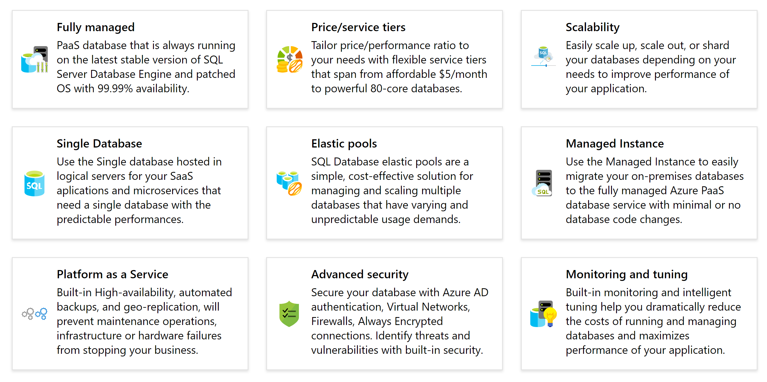
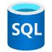
Azure SQL Database
Azure SQL Database is a relational database-as-a-service (DBaaS) based on the latest stable version of Microsoft SQL Server Database Engine. SQL Database is a high-performance, reliable, and secure database you can use to build data-driven applications and websites in the programming language of your choice, without needing to manage infrastructure.
https://docs.microsoft.com/en-us/azure/sql-database/

Slide 20
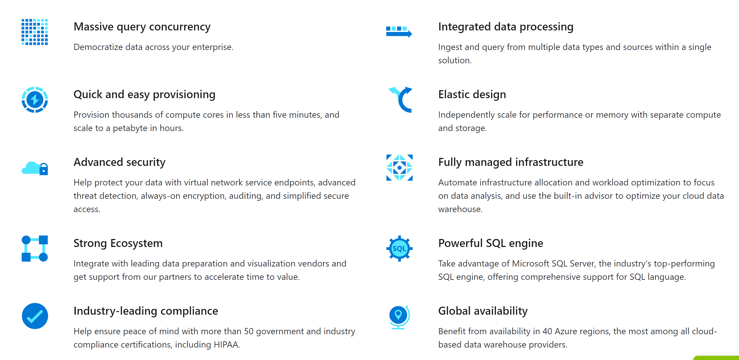

Azure Synapse Analytics
Synapse Analytics is an enterprise analytics service that includes a data warehousing product along with SQL and Spark runtimes for quickly run complex queries across petabytes of data.
https://docs.microsoft.com/en-us/azure/sql-data-warehouse/

Slide 21
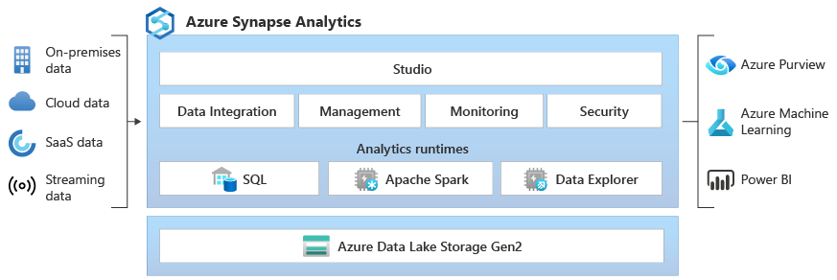

Slide 22
Pool Party!
Serverless SQL Pools
The first and, in my opinion, most flexible pool type is the Serverless SQL Pool.
Dedicated SQL Pools
In contrast to Serverless SQL Pools, Dedicated SQL Pools are provisioned at a specific size, and you pay for them while they are turned on, no matter how much data is being processed.
Serverless Spark Pools
The last type of pool is a Serverless Spark Pool, which creates a Spark session in the background.
This pool type allows you to use SQL without having to reserve a certain capacity of compute.
You're charged based on how much data the pool processes rather than the number of physical nodes that are used.
I would recommend this pool type for ad hoc querying of data, especially if you want to simply read and query data from your data lake.
This type of pool is ideal for larger, complex data querying or otherwise planned tasks.
Why? Because you can turn Dedicated Pools off and avoid charges after you're done. With Dedicated Pools, you pick a specified performance level, which is measured in obscure units called “Data Warehouse Units" or DWUs.
The more DWUs, the more CPU cores, memory, and data I/O are available to be utilized.
This allows users to utilize SparkSQL functionality inside of Synapse. The benefit?
This pool type is similar to the Serverless SQL Pool in that you are charged based on the amount of data that's processed.
This also allows you to install Spark libraries on the pool, which is perfect if you have packages that make certain data processing tasks easier.
Highly distributed and scalable processing of data in a Spark cluster, which can speed up some complex data transformation tasks that might otherwise take longer in traditional SQL.

Slide 23

What is Polybase?
PolyBase enables your SQL instance to process T-SQL queries that read data from an external data source such as Azure Storage locations as an
“EXTERNAL TABLE".
https://docs.microsoft.com/en-us/sql/relational-databases/polybase/polybase-guide?view=sql-server-2017
https://docs.microsoft.com/en-us/sql/relational-databases/polybase/polybase-versioned-feature-summary?view=sql-server-2017

Slide 24
Just because you need to create a data warehouse, you may not need to you use Azure Synapse. -But Why?

Slide 25
Azure SQL DB vs. Azure Synapse
Capability | Azure SQL Database | Azure Synapse
Data type | Relational | Relational
Active geo-replication | Yes | No
Dynamic Data Masking | Yes | No
Data Encryption at rest | Yes | Yes
Polybase T-SQL queries | No | Yes
Automatic Tuning | Yes | No
Massive Parallel Processing (MPP) | No | Yes
Ability to pause and resume | No | Yes
Max amount of data per database | 4TB | 1PB
Max concurrent open sessions | 30000 | 1024
Max concurrent queries | 6400 | 128
https://stackify.com/azure-sql-database-vs-warehouse/
https://docs.microsoft.com/en-us/azure/sql-data-warehouse/sql-data-warehouse-service-capacity-limits

Slide 26
But What About Costs?
1TB of Data
SQL DB
Factors:
Serverless vs. Provisioned
Redundancy
vCores (or DTUs)
Cost Range:
$150 - $1,000 per Month
Synapse
Factors:
Pool Type
Pool Usage
Storage
DWUs
Cost Range:
$75 - $10,000 per Month

Slide 27
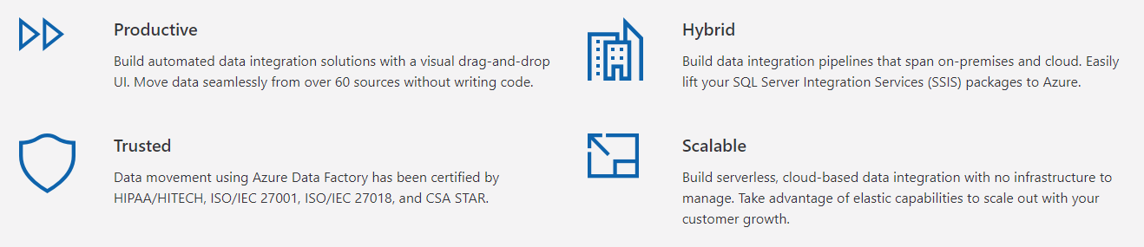

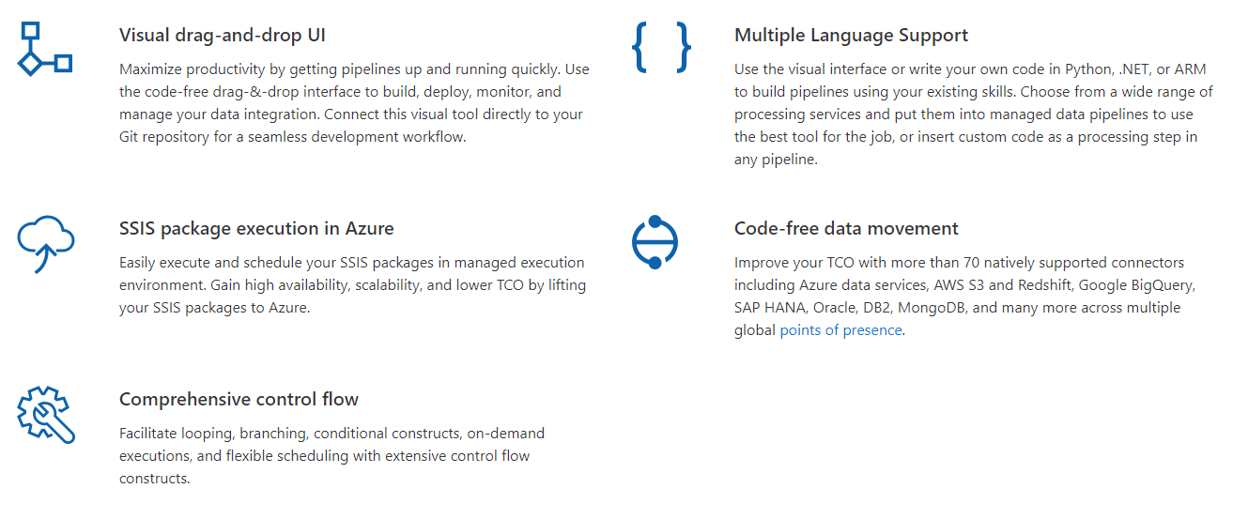
Azure Data Factory
Azure Data Factory is a cloud-based, hybrid data integration tool for creating data pipelines at scale. Complete with 70 data sources connectors and a slick UI, think of Data Factory as SSIS in the cloud.
https://docs.microsoft.com/en-us/azure/data-factory/

Slide 28

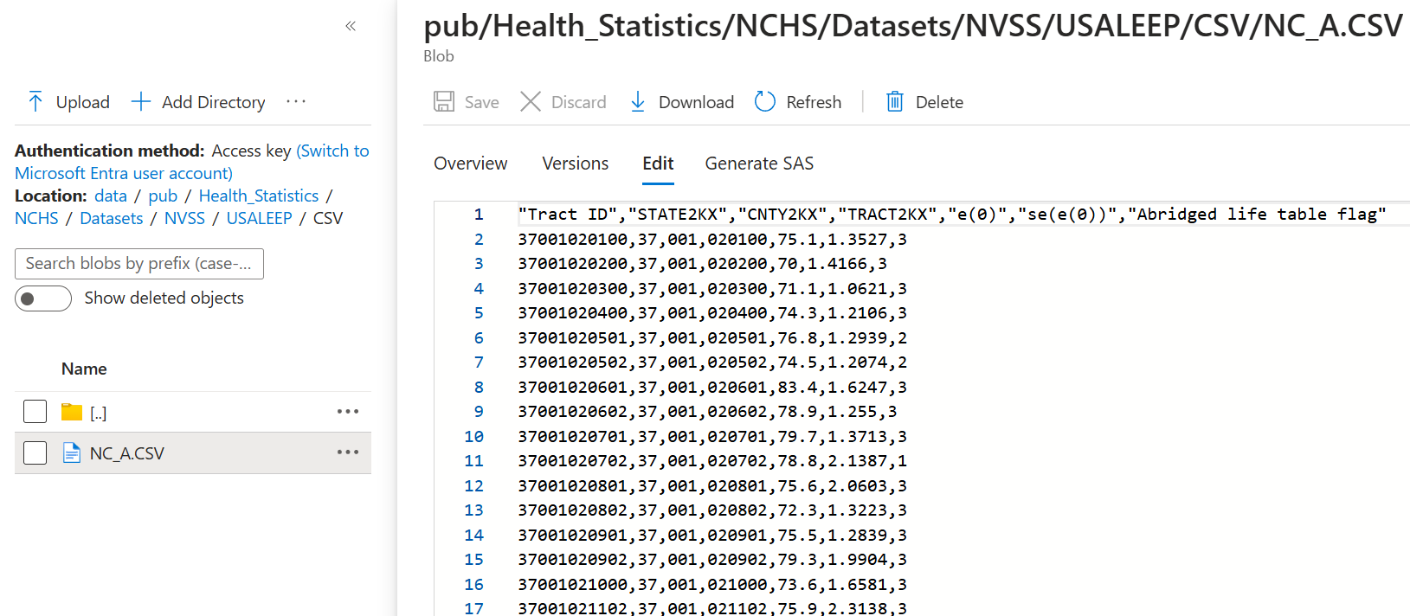
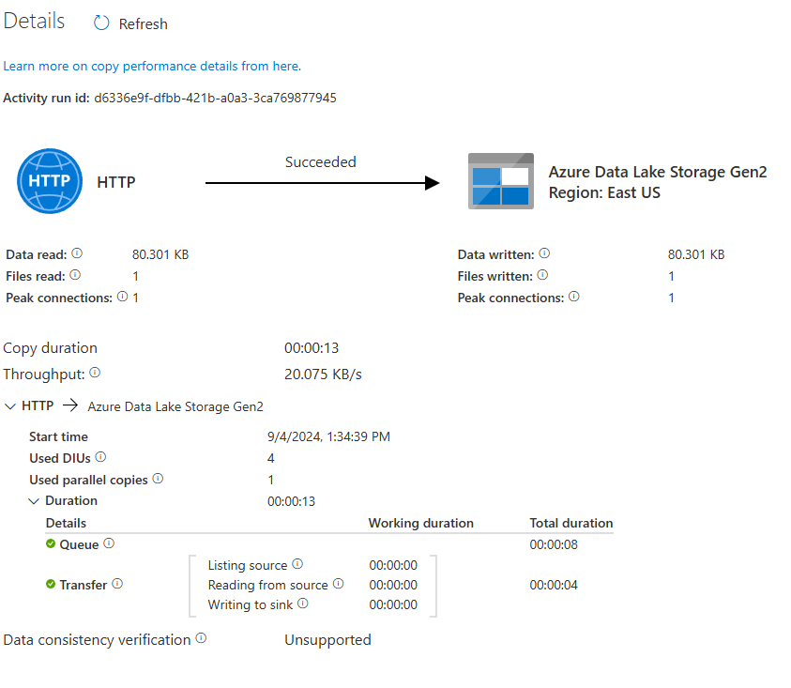
CDC Data Transfer Example
U.S. Small-area Life Expectancy Estimates Project – USALEEP Example Data: https://www.cdc.gov/nchs/nvss/usaleep/usaleep.html
ftp.cdc.gov - /pub/Health_Statistics/NCHS/Datasets/NVSS/USALEEP/CSV/

Slide 29
Begin lab…

Slide 30
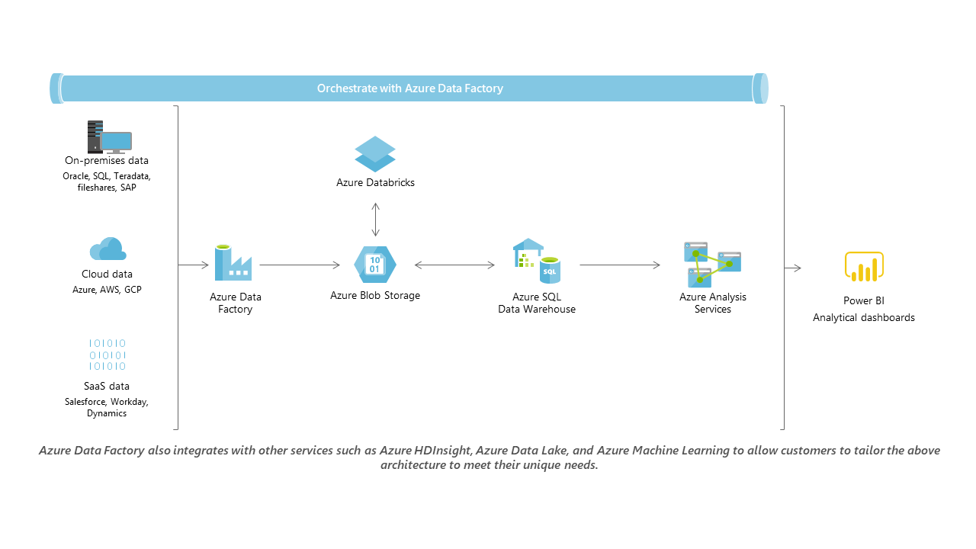
https://docs.microsoft.com/en-us/azure/architecture/data-guide/

Slide 31






Example Architecture
Machine
Learning
Databricks
On-Prem
Data
Other Cloud
Data
Data Factory
Storage /
Data Lake
Synapse
Power BI
SaaS
Data
https://docs.microsoft.com/en-us/azure/architecture/data-guide/

Slide 32
Containerization

Slide 33
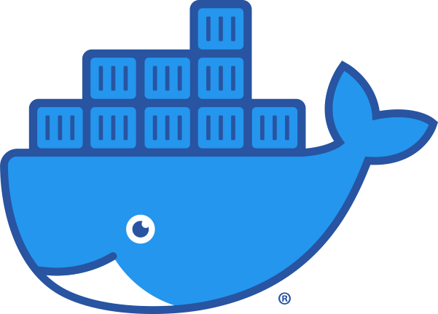
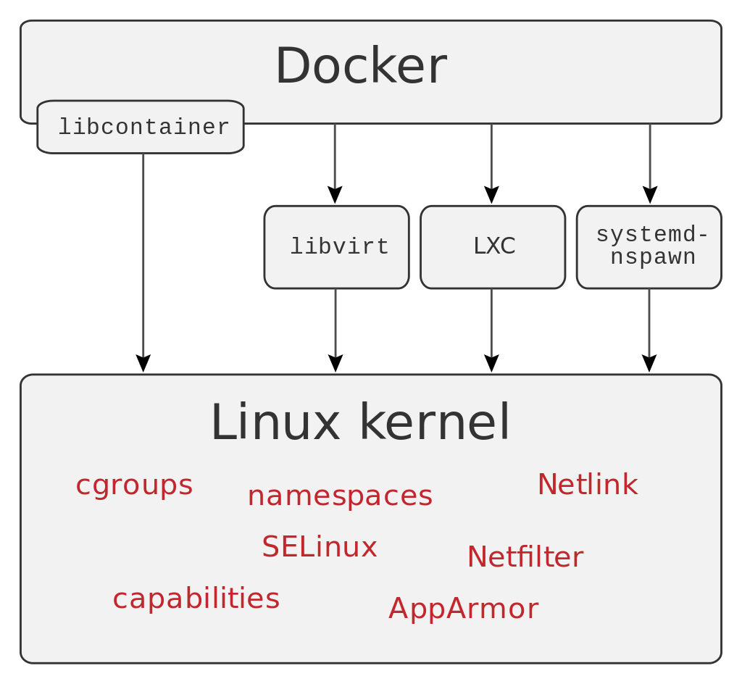
Docker
“Whale, hello there.”
Support for Linux and Windows Server containers (and now WebAssembly).
Flexibility to support microservices and traditional app workloads.
Integrated graphical user interface-based management and operation.
Granular role-based access control, LDAP, and Azure Active Directory integration.
Connection to custom networking and volumes (data storage)
Think of Docker is a trimmed down VM image with sets of packages and settings that are configured for reuse.
Notes:
cgroups – control groups
SELinux – Security Enhances Linux

Slide 34
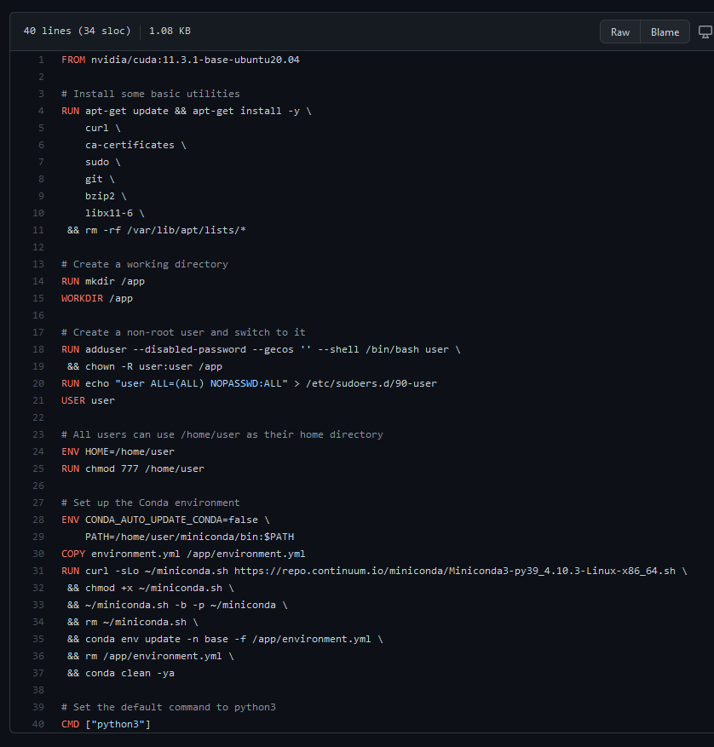

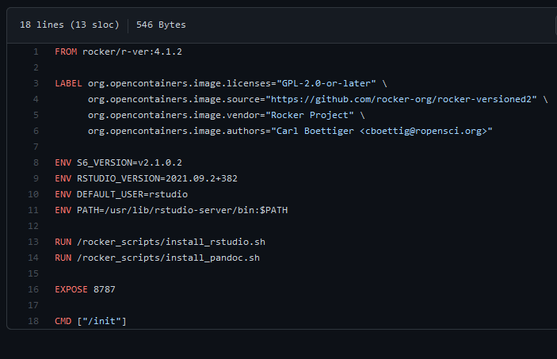

Dockerfile
Contains layers of instructions for configuring the system and installing libraries and files.
Specifies a base layer, which is useful for “picking up where someone left off”

Slide 35

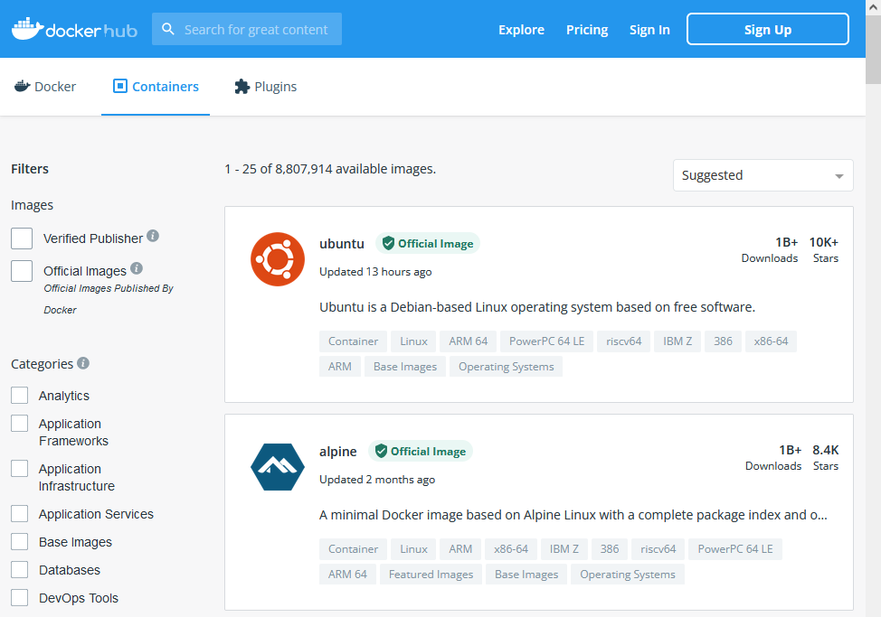
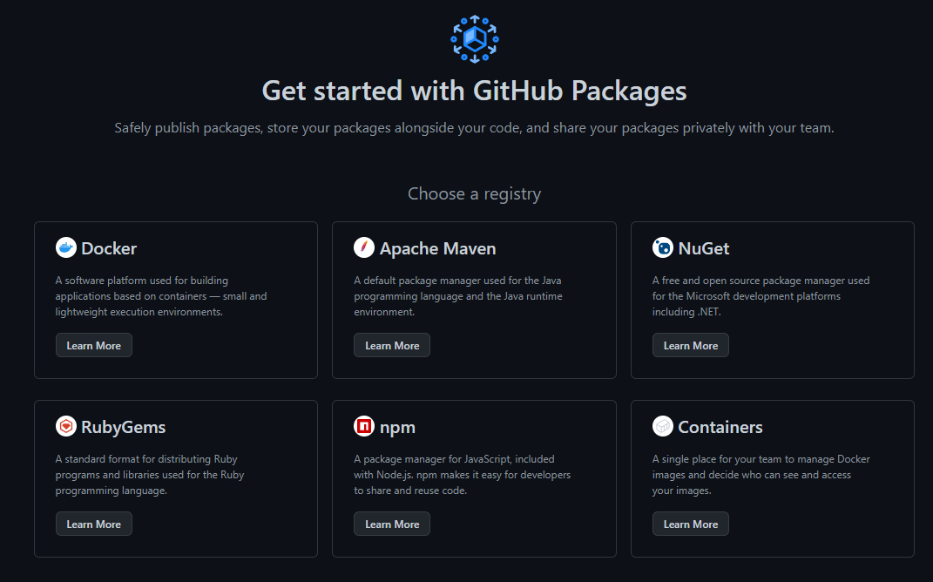
Container Storage
Azure Container Registry
GitHub Packages
DockerHub

Slide 36

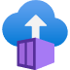
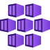
Container Usage
Deploy containerized applications to Azure for quick and scalable use.
Pick the Runtime Stack (Node, .NET, Python, etc.) and OS (Linux or Windows)
Pick the size of machine (RAM, CPUs, GPUs)
Azure Web Apps
Azure Container Instances
Azure Kubernetes Service

Slide 37


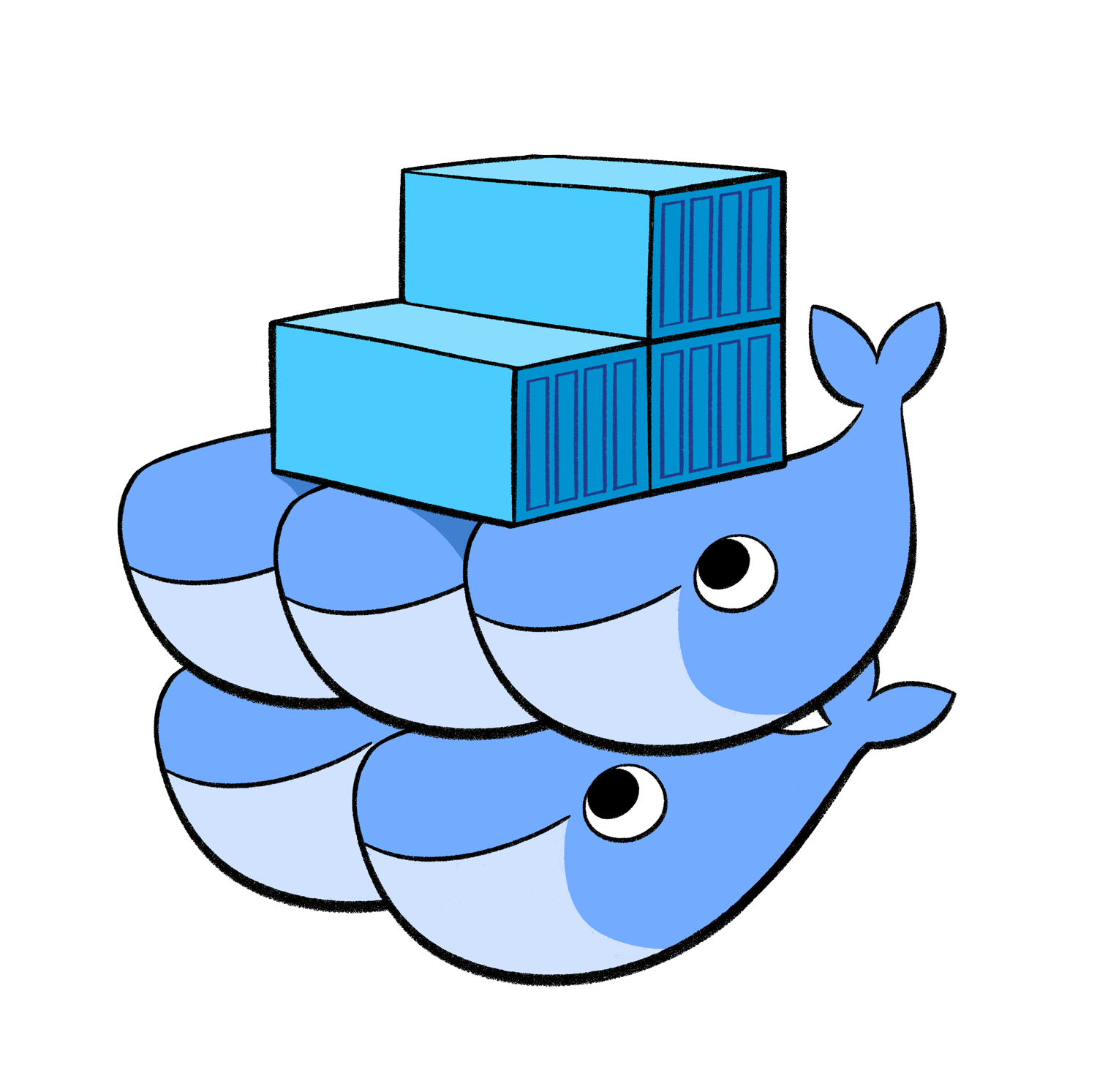

Container Orchestration
Once containers are created, use container orchestration to organize, coordinate, and schedule their use.
Useful for scaling containers and making use of distributed environments
Other capabilities:
Security management
API Serving
Resource Monitoring
Load Balancing
https://azure.microsoft.com/en-us/resources/videos/azure-kubernetes-service-overview/

Slide 38
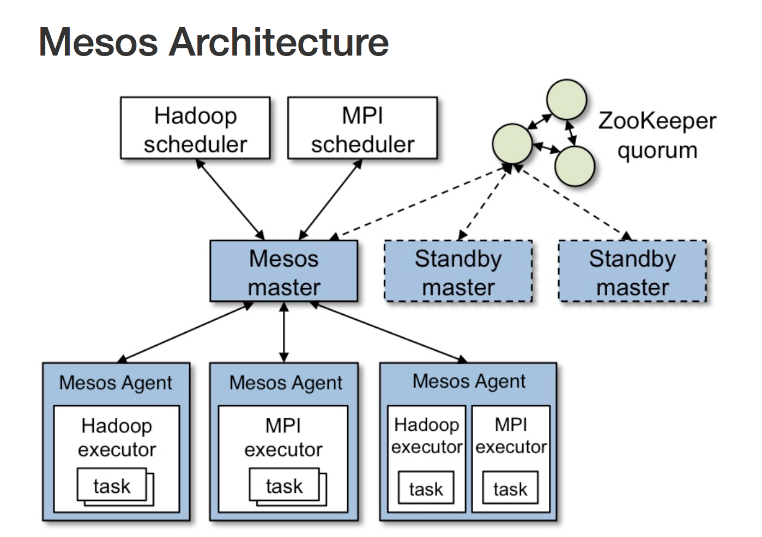
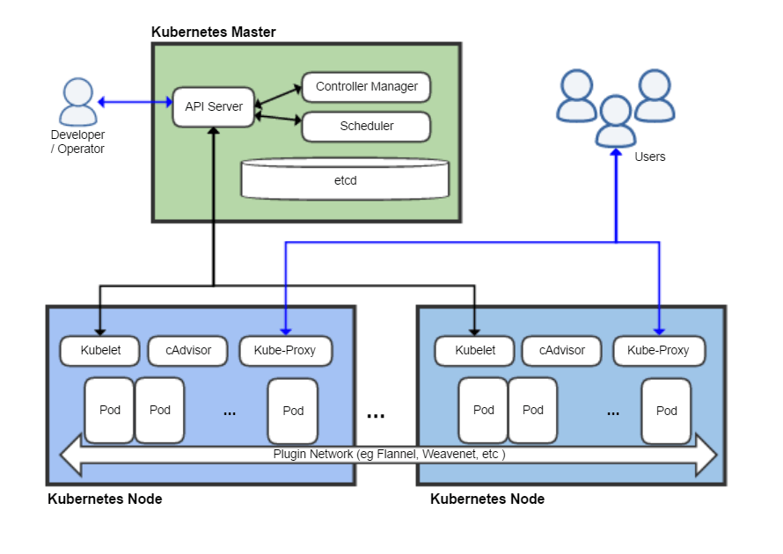

Slide 39
Bioinformatics Pipelines in AKS
Kubernetes + Queue-Based Architecture
Task A Queue
AKS
Control Plane
Provision Pods (or Remove Dead Pods)
Active Queue
A Nodepool
Task B Queue
…
Request Pods
Pod₁
Pod_{n}
Send Task Information
Finished Queue
Queue Master
(single node)
B Nodepool
Task C Queue
…
Pod₁
Pod_{n}
C Nodepool
…
Pod₁
Pod_{n}
Update Status Queues
…
…

